Slide 1
Jermyn Borough Council Meeting
7/28/22

Slide 2
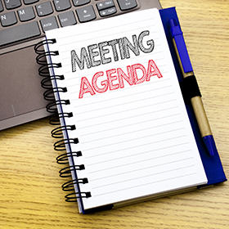
Meeting Agenda
July 28, 2022
CALL TO ORDER
PLEDGE OF ALLEGIANCE
ROLL CALL
PREVIOUS MEETING MINUTES
TREASURER REPORT/BILLS PAYABLE
CORRESPONDENCE
PUBLIC COMMENT
PROFESSIONAL REPORTS
POLICE
FIRE
EMA
SOLICITOR
CODE ENFORCEMENT
ZONING
ENGINEER
TAX COLLECTOR
MAYOR
COMMITTEE REPORTS
WASH AVE ISSUES (423-25, 427,536 AND 542)
COMCAST
GEO SCIENCE
SAFETY OF WASHINGTON AVE TREES (PLANNING COMM CONCERN)
500 BLOCK OF MELLOW CT
DWIGHT AVE PAVING
GFL/COUNTY WASTE
NEW BUSINESS

Slide 3
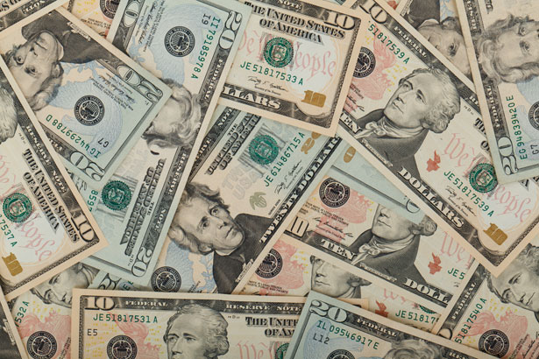
Treasurer’s report
7/28/22
ASSETS
Checking/Savings
Capital Reserve - DPW 10,727.00
Capital Reserve - Police 4,761.82
Crime Watch Fund 222.69
General Fund - Community 211,661.70
General Fund - FNB 5,497.91
Holiday Lights Fund 1,374.09

Slide 4
Treasurer’s report
Investment - General Fund 1,002.43
Investment - Liquid Fuels 33,844.67
Investment - Paving Fund 1,012.83
Investment - Recycling 5,007.95
Investment - Refuse 2,602.57
Liquid Fuels - FNB 47,900.32
Petty Cash 231.00
Recreations Fund 20,741.24
Recycling - Community 10,406.84
Refuse Checking - FNB 135,372.80
Total Checking/Savings 492,367.86

Slide 5
Treasurer’s report
200000 · Accounts Payable 25,001.52
Long Term Debt 241,056.16

Slide 6
MS4 Minute
https://youtu.be/S9xZadqjZl4

